Slide 1





















SwarmGenomics Genomic Features and Genomic analyses Heterozygosity, Runs of Homozygosity and PSMC
ATGCTTCGCGAACGTACGTCGCGAACATTATGCTTCGCGAACGTACGTACGTAGGT

Slide 2
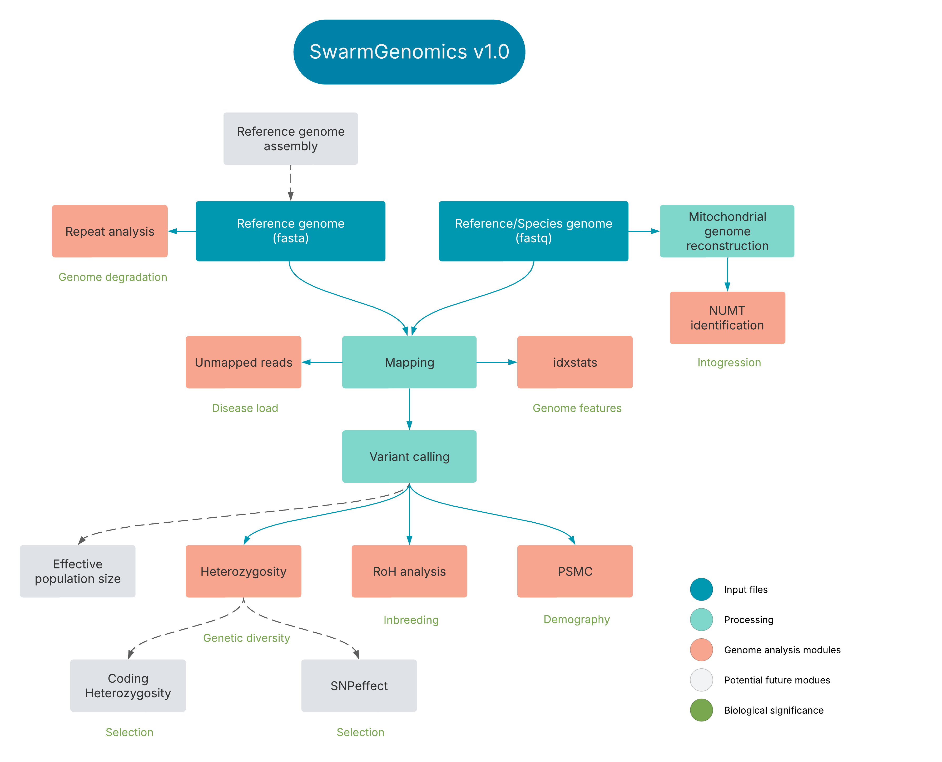

Slide 3
Genome Features - idxstats
Quick summary of alignment statistics from a BAM file
BAM = Binary Alignment Map
Aligned sequence data in compressed format
View of how well the reads aligned to different parts of the genome
Output includes:
Reference name (e.g., chromosome or scaffold)
Reference length
Number of mapped reads
Number of unmapped reads

Slide 4
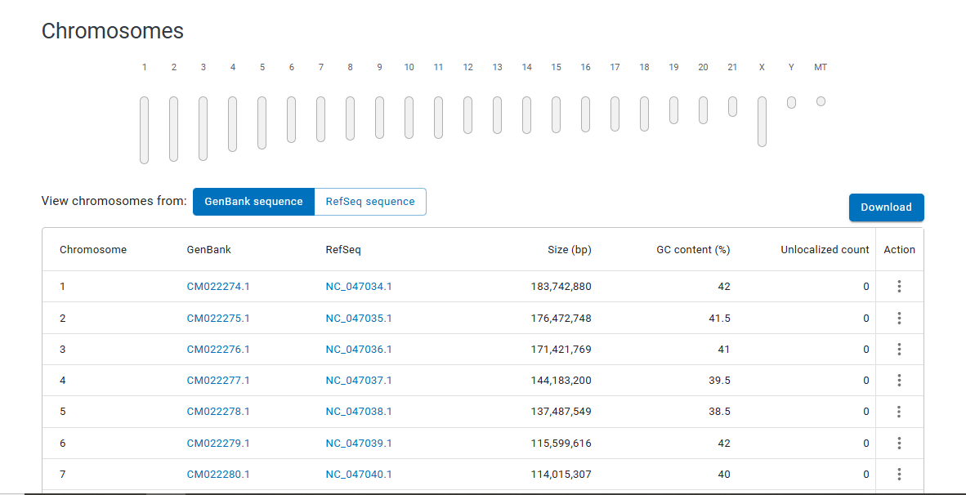
Genome Features - Scaffolds
Sequences in a genome assembly that may contain gaps but represent larger contiguous pieces of the genome
Analysing the largest scaffolds targets the most biologically meaningful or complete parts of the genome
Best approximation of chromosomes
https://www.ncbi.nlm.nih.gov/datasets/genome/

Slide 5
Genome Features – Unmapped reads
Reads that do not align to any part of the reference genome
Reasons include:
Sequencing errors
Contamination
Reference incompleteness
Real biological differences (e.g., novel insertions)
High numbers of unmapped reads may indicate:
Problems with the sequencing run
Poor genome assembly quality
Presence of unknown or unrepresented sequences (e.g., contamination or novel content)

Slide 6

Genome Features - Coverage
How many times a base or region is sequenced
Coverage is critical for:
Confidence in variant calling
Identifying duplicated or deleted regions
Ensuring uniformity in sequencing (low or zero coverage = potential issues)
$$Coverage=\frac{Number of Mapped Reads×Read Length}{Genome Size}​$$

Slide 7
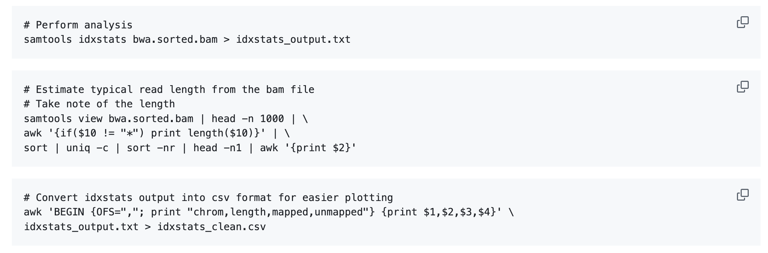
04. Genome features on GitHub
Follow instructions on:
https://github.com/AureKylmanen/Swarmgenomics/blob/main/04.%20Genome%20features.md

Slide 8
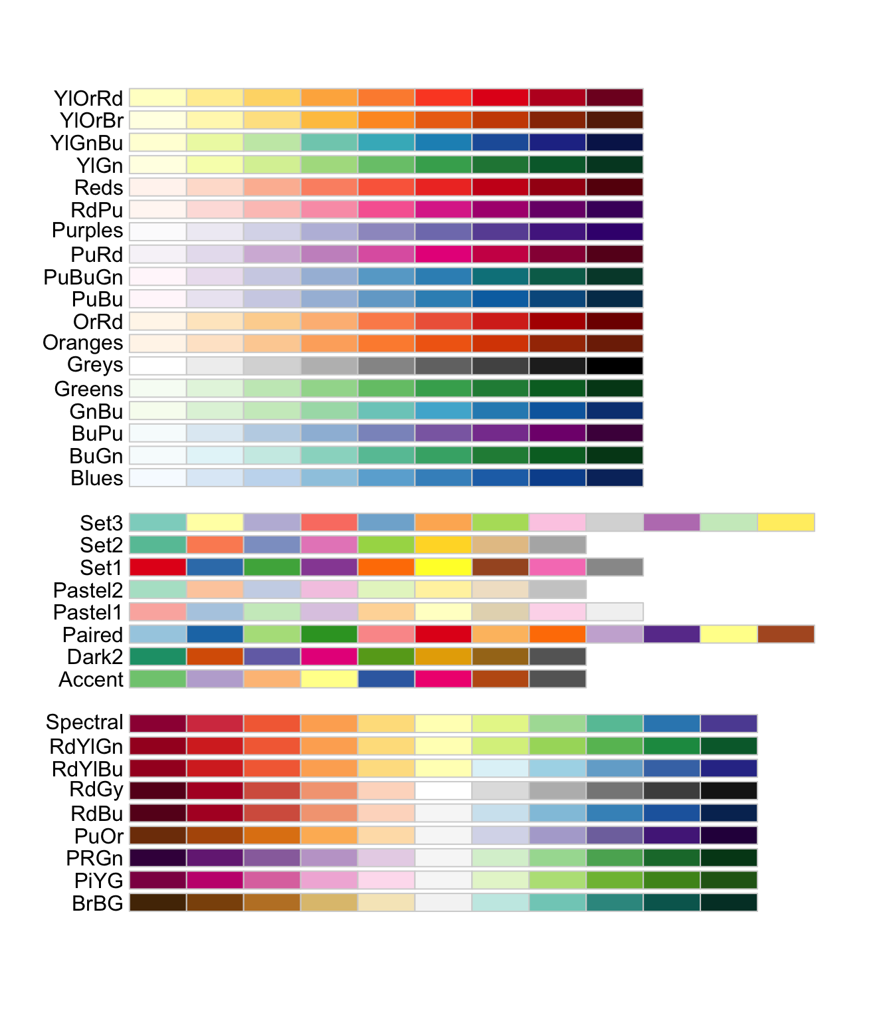
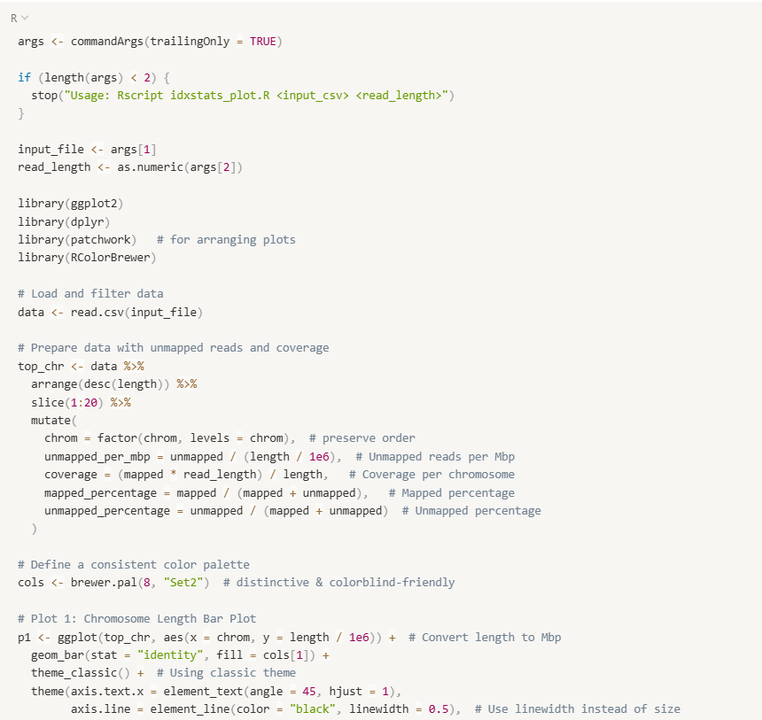
Editing idxstats.R
Change the number of plotted scaffolds
Change colour palette

Slide 10
Genomic modules
The “genomic modules” are grouped together because they use the same input files = VCF files
VCF = Variant Call Format
It’s a text file that lists the genetic variants (differences from a reference genome) found when you sequence an individual or population.
Each line describes:
Position in the genome
Reference allele (what’s in the reference genome)
Alternate allele(s) (the variant(s) you found)
Genotype calls for each sample (e.g., 0/0 = homozygous reference, 0/1 = heterozygous, 1/1 = homozygous alternate).

Slide 11
Genomic modules
A VCF file is the standard way to record genetic variants.
It’s used for:
Heterozygosity → count heterozygous genotypes.
ROH → find long homozygous stretches.
PSMC → analyze distribution of heterozygous sites over the genome to infer past population sizes.

Slide 12
Genomic modules - Heterozygosity
Heterozygosity = having two different alleles at a genetic site
Shows how much genetic variation exists across the genome

Slide 13
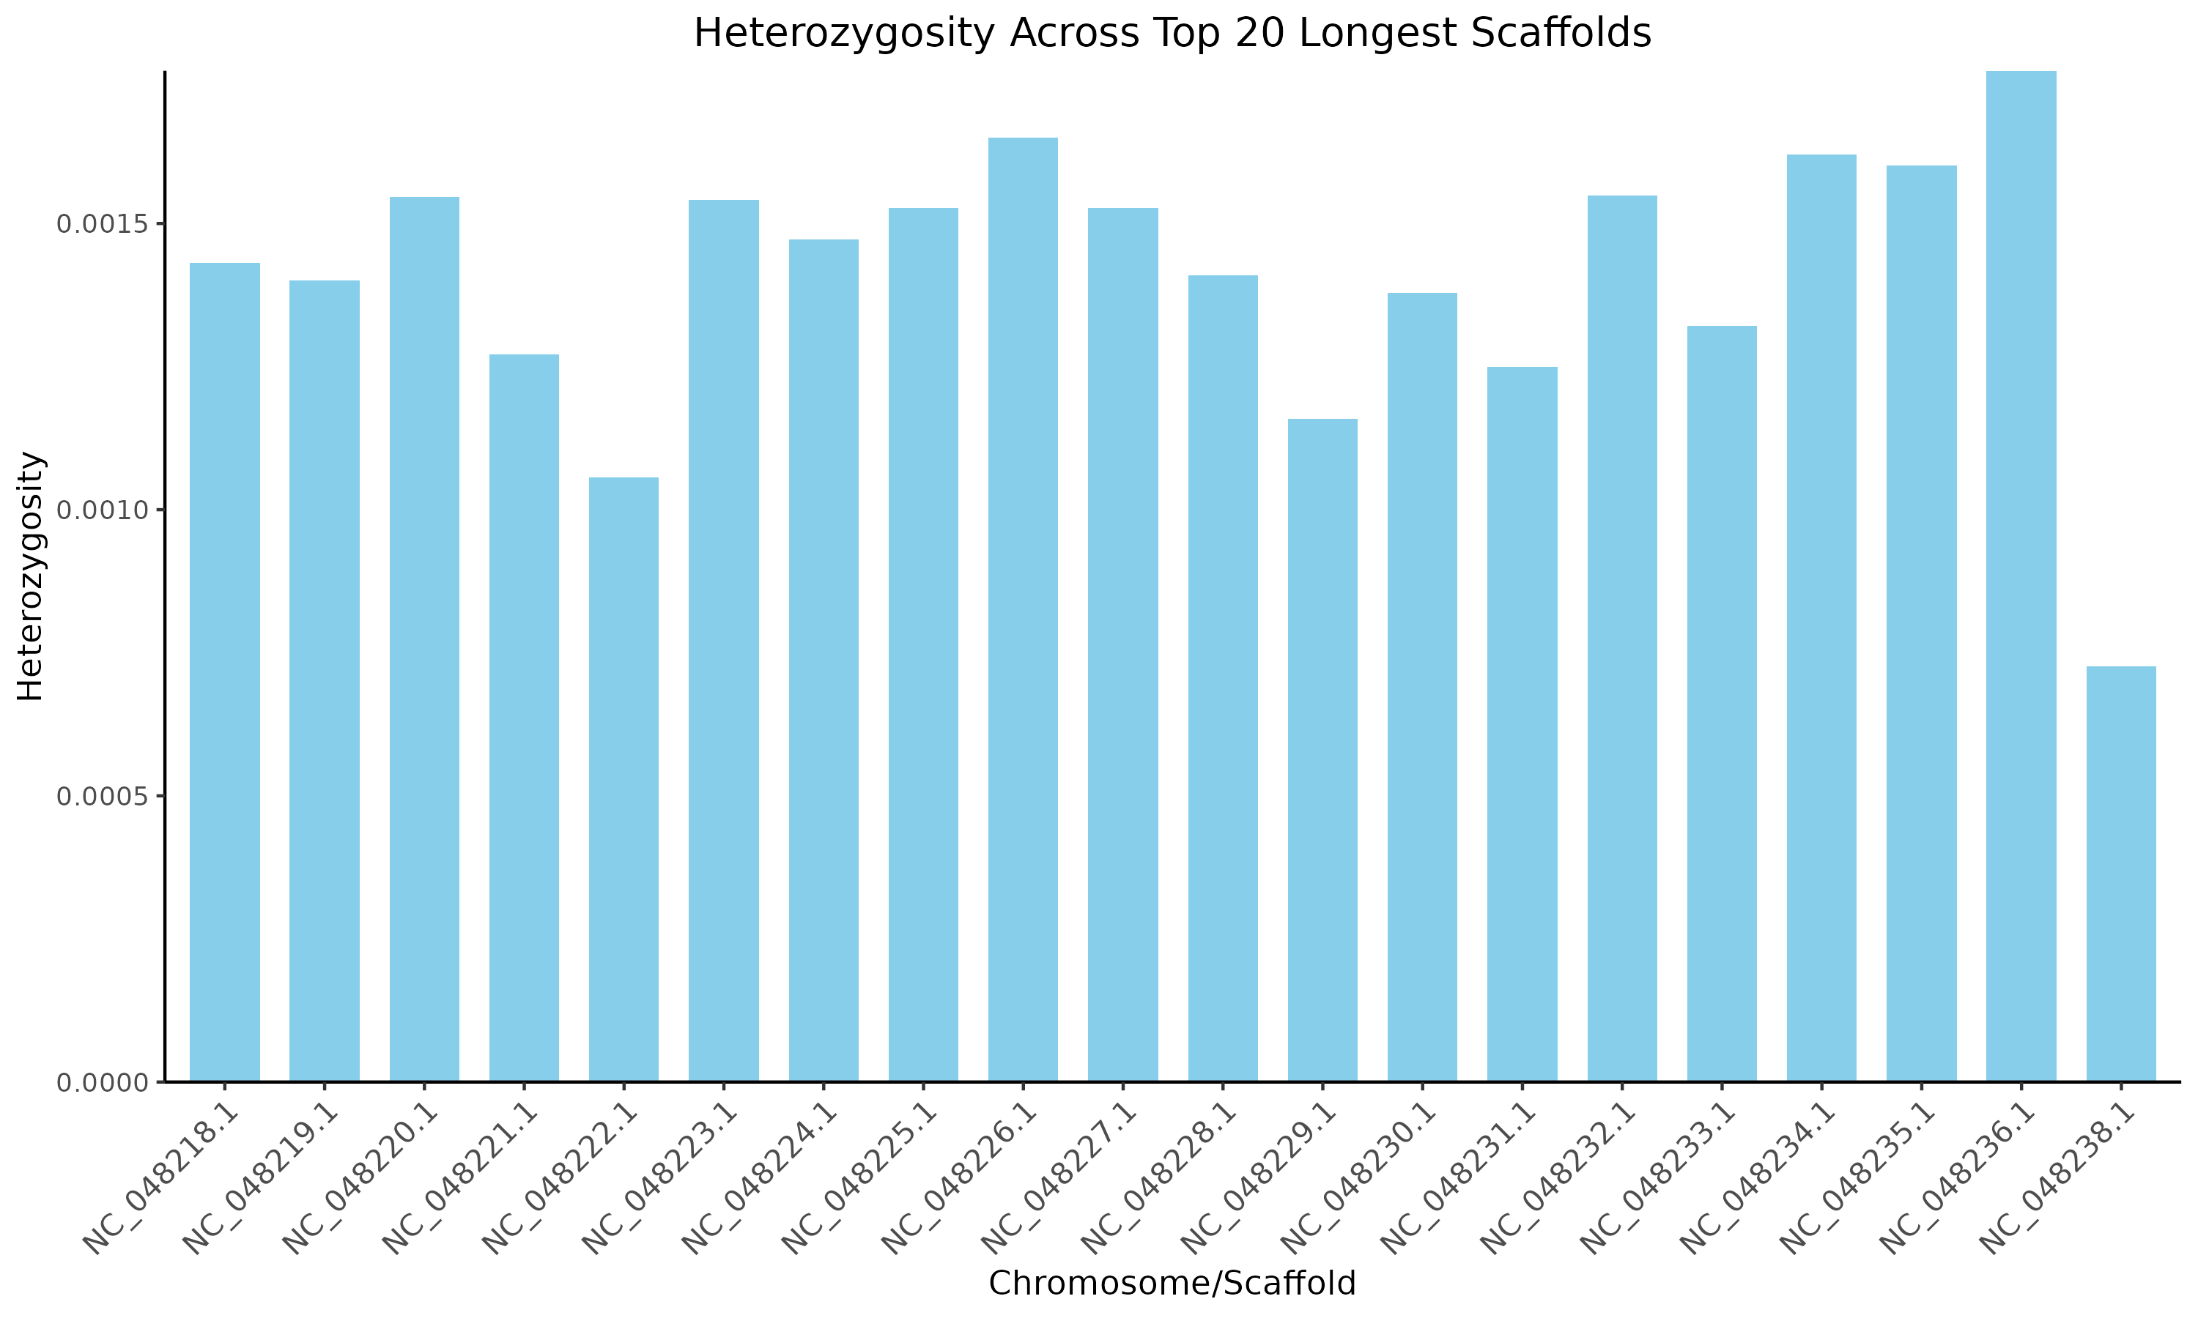
Genomic modules - Heterozygosity

Slide 14
Genomic modules - Heterozygosity
Heterozygosity Value | Interpretation | Possible Biological Meaning | Possible Technical Cause
> 0.01 | Very high | Admixture, recent gene flow, or hypervariable regions | Misalignment, repetitive regions
0.005 – 0.01 | High | Outbred individuals, large Ne, recombination hotspots | Sequencing/mapping errors
0.001 – 0.005 | Moderate (expected range) | Healthy levels of variation in most natural populations | —
0.0001 – 0.001 | Low | Small population size, mild inbreeding | Filtering too strict, poor coverage
< 0.0001 | Very low | Strong inbreeding, recent bottlenecks, or selection sweeps | Assembly errors, reference bias
0 | No variation | Identical chromosomes (e.g. from inbreeding or sex chromosomes) | Masked/missing data

Slide 15
Genomic modules – Runs of Homozygosity
RoHs = long stretches of DNA with no variation (homozygous)
Formed when the same DNA is inherited from both parents
Long RoHs → recent inbreeding (e.g. cousins mating)
Short RoHs → older population bottlenecks
Can estimate inbreeding levels and demographic history

Slide 16
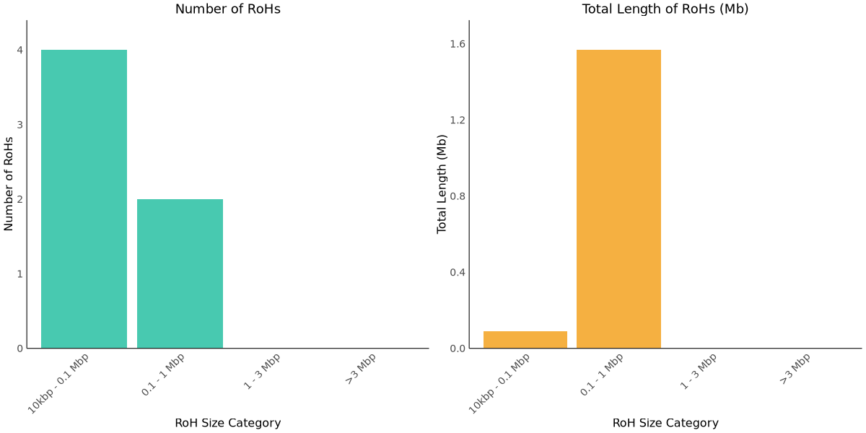
Genomic modules – Runs of Homozygosity

Slide 17
Genomic modules – Runs of Homozygosity
ROH Length | What It Indicates | Interpretation
>10 Mb | Very recent inbreeding | Likely from parents that were closely related (e.g. siblings or cousins)
1–10 Mb | Recent inbreeding | Common ancestor 2–6 generations ago
0.1–1 Mb | Older or background inbreeding | Reflects older shared ancestry; population bottlenecks
<0.1 Mb | Ancient or common variation | May reflect deep shared ancestry or genome structure

Slide 18
Genomic modules – PSMC
PSMC = Pairwise Sequentially Markovian Coalescent
Uses just one diploid genome to infer changes in population size
Analyzes regions of the genome with more or less variation
Tells how population size changed over time
PSMC is more accurate for long-term trends; recent events (<10k years) may be less reliable.

Slide 19
Genomic modules – PSMC
Input: You start with a diploid genome, where heterozygous and homozygous sites are identified across the genome.
Hidden Markov Model (HMM): PSMC divides the genome into chunks and uses a Hidden Markov Model to estimate how long ago the two chromosome copies coalesced (i.e., found a common ancestor) at each chunk.
Assumption: Regions with lots of heterozygous sites → more recent common ancestors (coalescence happens sooner). Regions with few heterozygous sites → older coalescence (fewer mutations have accumulated).
Sequential Model: It moves along the genome in sequence, assuming that the coalescent time at each region depends on the previous one, like a Markov process
Reconstruction: By fitting this model, PSMC reconstructs a population size history, where smaller effective population sizes produce shorter coalescence times (more related chromosomes), and larger populations produce longer coalescence times (more genetic diversity).

Slide 20
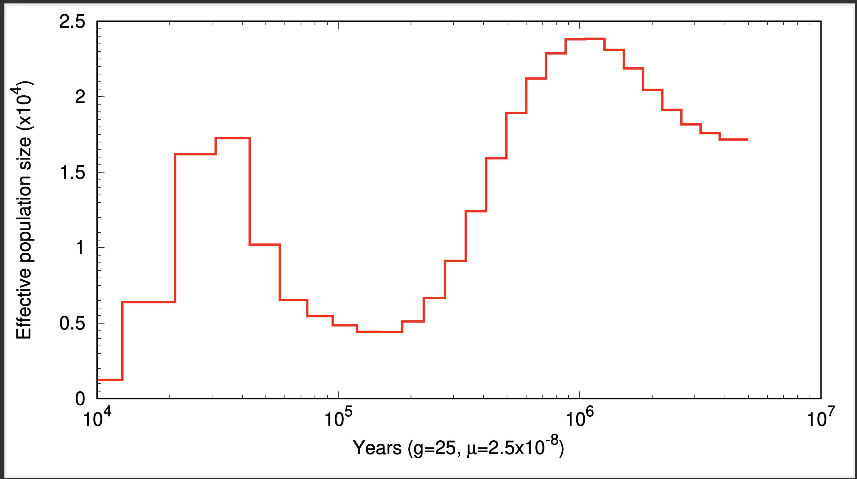
Genomic modules – PSMC
Decline in population size
Present
Past

Slide 21
001. Fast-track SwarmGenomics
https://github.com/AureKylmanen/Swarmgenomics/edit/main/001.%20Fast-track%20SwarmGenomics.md

Slide 22
Genomic modules - Scripts
Download scripts from GitHub
genomic_modules.bash
all_roh_bar_plots.R
plot_heterozygosity.R
idxstats.R
Edit genomic_modules.bash
WORKING_DIR="/vol/storage/swarmgenomics/your_name“
BCFTOOLS="/vol/storage/software/bcftools-1.17/bcftools“

Slide 23
Genomic modules - Scripts
Make scripts executable
chmod +x genomic_modules.bash
And in correct format (if edited on notepad)
dos2unix genomic_modules.bash all_roh_bar_plots.R idxstats.R plot_heterozygosity.R
Run genomic_modules.bash
nohup ./genomic_modules.bash “your_species” &

Slide 24
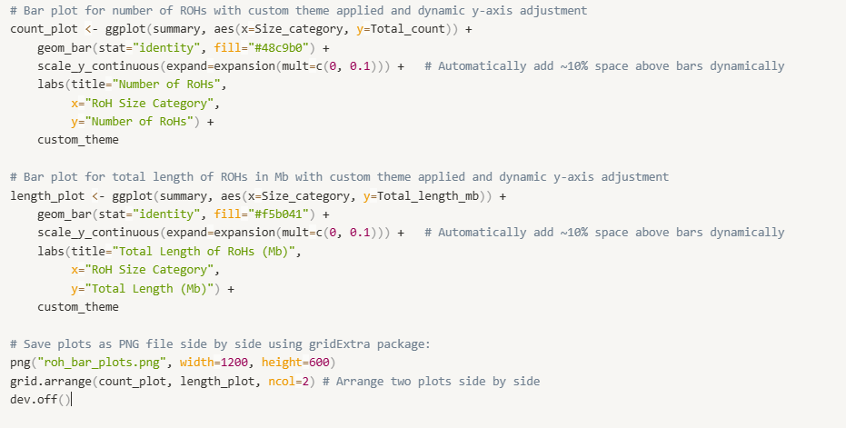
Replotting the results
You can edit the R scripts for plotting to change colour etc.
Use vim to edit in terminal:
vim all_roh_bar_plots.R
Run the script in the same directory where your results are with:
Rscript all_roh_bar_plots.R

